Slide 1

Department of Computer Engineering
Nonlinear Data Structure
Data Structure 01CE0301 / 3130702
Unit#3
Ravikumar Natarajan

Slide 2
Unit#3: Nonlinear Data Structure
Highlights
Trees
Graphs

Slide 3
Unit#3: Nonlinear Data Structure
Tree deﬁnitions and their concepts
Representation of binary tree
Binary tree traversal
Binary search trees
General trees vs binary trees
Threaded binary tree
Applications of Trees
Balanced tree and its mechanism
Height and Weight Balanced Trees
Till Now
Trees
Graphs

Slide 4
Unit#3: Nonlinear Data Structure
Graphs and their understanding
Matrix representations of a given graph
Depth First Search (DFS)
Breadth First Search (BFS)
Minimum Spanning Trees Algorithms (Prims, Kruskal, Dijkstra)
Path Matrix
Warshall’s Algorithm
Up Next
Trees
Graphs

Slide 5
Unit#3: Nonlinear Data Structure
Graph G = (V, E)
V = set of vertices
E = set of edges ⊆ (V × V)
Introduction
A
A
B
B
C
C
D
D
E
E
Undirected Graph
Directed Graph

Slide 6
Unit#3: Nonlinear Data Structure
Types of graphs
Undirected: edge (u, v) = (v, u); for all v, (v, v) ∉ E (No self loops.)
Directed: (u, v) is edge from u to v, denoted as u → v. Self loops are allowed.
Weighted: each edge has an associated weight, given
by a weight function w : E → R.
Dense: |E| ≈ |V|².
Sparse: |E| << |V|².
Complete: Undirected. Every vertex has an edge to all other vertex. Complete graph with N vertices has N(N+1)/2 edges.
Introduction

Slide 7
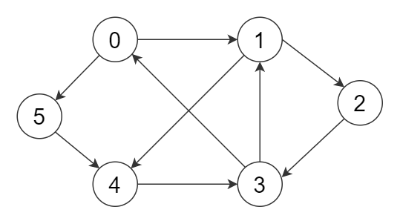
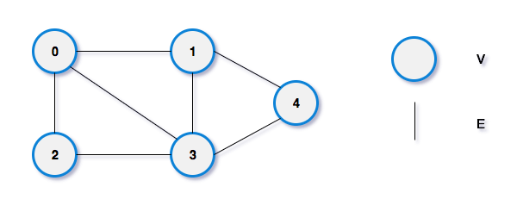
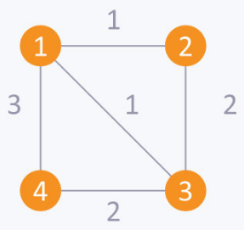
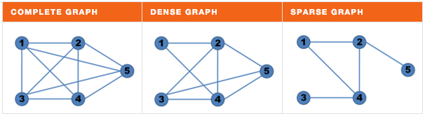
Directed Graph
Undirected Graph
Weighted Graph
Types of graphs
Notes:
Dense graph is a graph in which the number of edges is close to the maximal number of edges. Sparse graph is a graph in which the number of edges is close to the minimal number of edges.

Slide 8
Unit#3: Nonlinear Data Structure
Adjacent Nodes: Two vertices are adjacent if they are endpoints of the same edge.
An edge is incident on a vertex if the vertex is an endpoint of the edge.
Outgoing edges of a vertex are directed edges that the vertex is the origin.
Incoming edges of a vertex are directed edges that the vertex is the destination.
Degree of a vertex, v, denoted deg(v) is the number of incident edges.
Out-degree, outdeg(v), is the number of outgoing edges.
In-degree, indeg(v), is the number of incoming edges.
Introduction

Slide 9
Unit#3: Nonlinear Data Structure
A path is a sequence of vertices such that each vertex is adjacent to the next. In a path, each edge can be traveled only once.
The length of a path is the number of edges in that path.
Cycle(loop) is a path that starts and end at the same vertex.
In a weighted graph, every edge is assigned some weight or length(positive value).
Introduction

Slide 10
Unit#3: Nonlinear Data Structure
If (u, v) ∈ E, then vertex v is adjacent to vertex u.
Adjacency relationship is:
Symmetric if G is undirected.
Not necessarily so, if G is directed.
Introduction
If G is connected:
There is a path between every pair of vertices.
|E| ≥ |V| – 1.
Furthermore, if |E| = |V| – 1, then G is a tree.

Slide 11
Unit#3: Nonlinear Data Structure
Two standard ways.
A
B
Representation of Graphs
C
D
Adjacency Matrix
Adjacency Lists
 | A | B | C | D
A | 0 | 1 | 1 | 1
B | 1 | 0 | 1 | 0
C | 1 | 1 | 0 | 1
D | 1 | 0 | 1 | 0
A
B
C
D
/
B
A
C
/
C
A
B
D
/
D
A
C
/

Slide 12
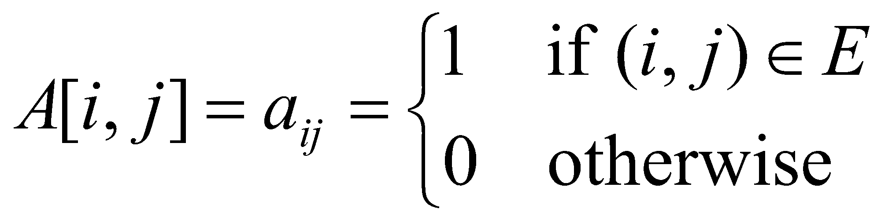
Unit#3: Nonlinear Data Structure
|V| × |V| matrix A.
Number vertices from 1 to |V| in some arbitrary manner.
Used for dense graph. Space complexity θ (n²)
A is then given by:
Adjacency Matrix
 | 1 | 2 | 3 | 4 |  |  | 1 | 2 | 3 | 4
1 | 0 | 1 | 1 | ₁ 1 2 |  | 1 | 0 | 1 | 1 | 1
2 | 1 | 0 | 1 | 0 |  | 2 | 0 | 0 | 1 | 0
3 | 1 | 1 | 0 | 1 |  | 3 | 0 | 0 | 0 | 1
1
2
3
4
4 | 1 | 0 | 1 | ₀ 3 |  | 4 ₄ | 0 | 0 | 0 | 0
A = AT for undirected graphs.

Slide 13
Unit#3: Nonlinear Data Structure
Consists of an array Adj of |V| lists.
One list per vertex.
For u ∈ V, Adj[u] consists of all vertices adjacent to u.
If weighted, store weights also in adjacency lists.
Used for sparse graph
For undirected the space complexity is θ (n+2e)
For directed the space complexity is θ (n+e)
Adjacency Lists

Slide 14
Unit#3: Nonlinear Data Structure
A
B
C
D
/
A
B
B
A
C
/
C
A
B
D
/
Adjacency Lists
C
D
D
A
C
/
A
B
C
D
/
A
B
B
C
/
C
D
/
C
D
D
/

Slide 15
Unit#3: Nonlinear Data Structure
Graph traversal means visiting every vertex and edge exactly once in a well-defined order. While using certain graph algorithms, you must ensure that each vertex of the graph is visited exactly once.
The order in which the vertices are visited are important and may depend upon the algorithm or question that you are solving.
During a traversal, it is important that you track which vertices have been visited. The most common way of tracking vertices is to mark them.
Graph Traversal

Slide 16
Unit#3: Nonlinear Data Structure
Systematically follow the edges of a graph to visit the vertices of the graph.
Used to discover the structure of a graph.
Standard tree-traversal algorithms.
Traversing / Searching Graphs
Pre-order [root-left-right]
In-order [left-root-right]
Post-order [left-right-root]
Standard graph-searching algorithms.
Breadth-ﬁrst Search (BFS).
Depth-ﬁrst Search (DFS).

Slide 17
Unit#3: Nonlinear Data Structure
A standard BFS implementation puts each vertex of the graph into one of two categories:
Visited
Not Visited
The purpose of the algorithm is to mark each vertex as visited while avoiding cycles. BFS follows graph traversal technique.
The algorithm works as follows:
Select any vertex as starting vertex and insert that into the Queue and mark the status as visited.
While Queue is non empty
DELETE(dequeue) a vertex from the Queue and DISPLAY it.
INSERT(enqueue) all the unvisited adjacent vertices into the Queue and mark the status as visited.
Repeat step 2 until the Queue gets empty.
Breadth-ﬁrst Search

Slide 18
Unit#3: Nonlinear Data Structure
Algorithm
/* Array visited[] is initialized to O */
/* BFS traversal on the graph G is carried out beginning at vertex V */
Void BFS(int V)
{
q: a queue type variable;
initialize q;
visited[v] = 1; //mark v as visited
add the vertex V to queue q;
while(q is not empty)
{
v <- delete an element from the queue;
for all vertices w adjacent from V
{
if(!visited[w])
{
visited[w]=1;
add the vertex w to queue q;
}
}
}
Breadth-ﬁrst Search

Slide 19
Unit#3: Nonlinear Data Structure
Expands the frontier between discovered and undiscovered vertices uniformly across the breadth of the frontier.
A vertex is “discovered” the ﬁrst time it is encountered during the search.
A vertex is “ﬁnished” if all vertices adjacent to it have been discovered.
Breadth-ﬁrst Search
Colors the vertices to keep track of progress.
White – Undiscovered.
Gray – Discovered but not ﬁnished.
Black – Finished.

Slide 20
Unit#3: Nonlinear Data Structure
Algorithm:
Graph G = (V, E), either directed or undirected, and source vertex s ∈ V.
Output:
Breadth-ﬁrst Search
d[v] = distance (smallest # of edges, or shortest path) from s to v, for all v ∈ V. d[v] = ∞ if v is not reachable from s.
π[v] = u, such that (u, v) is last edge on shortest path s
to v. [u is v’s predecessor.]
Builds breadth-ﬁrst tree with root s that contains all reachable vertices.

Slide 21
Unit#3: Nonlinear Data Structure
Input:
Graph G = (V, E), either directed or undirected, and source vertex s ∈ V.
Output:
Breadth-ﬁrst Search
d[v] = distance (smallest # of edges, or shortest path) from s to v, for all v ∈ V. d[v] = ∞ if v is not reachable from s.
π[v] = u, such that (u, v) is last edge on shortest path s
to v. [u is v’s predecessor.]
Builds breadth-ﬁrst tree with root s that contains all reachable vertices.

Slide 22
BFS(G, s)
Unit#3: Nonlinear Data Structure
1. for each vertex u in V[G] – {s} do
2. color[u] ← white
3. d[u] ← ∞
4. π[u] ← nil
Breadth-ﬁrst Search
5. color[s] ← gray
6. d[s] ← 0
π[s] ← nil
Q ← Φ
enqueue(Q, s)
white: undiscovered gray: discovered black: finished
Q: a queue of discovered vertices
color[v]: color of v d[v]: distance from s to v π[u]: predecessor of v

Slide 23
10. while Q ≠ Φ do
Unit#3: Nonlinear Data Structure
u ← dequeue(Q)
for each v in Adj[u] do
if color[v] = white 14.
14.
15.
16.
17.
18. color[u] ← black
Breadth-ﬁrst Search
then
color[v] ← gray d[v] ← d[u] + 1 π[v] ← u enqueue(Q, v)
white: undiscovered gray: discovered black: finished
Q: a queue of discovered vertices
color[v]: color of v d[v]: distance from s to v π[u]: predecessor of v
Notes:
https://www.youtube.com/watch?v=x-VTfcmrLEQ

Slide 24
Unit#3: Nonlinear Data Structure
Given Graph:
r
s
t
u
Breadth-ﬁrst Search
v
w
x
y
Source s

Slide 25
Unit#3: Nonlinear Data Structure
V[G]
d[v]
π[v]
r s t u v w x y
r
s
t
u
v
w
x
y
Breadth-ﬁrst Search
Q:
u:
v:
white: undiscovered gray: discovered black: finished
Q: a queue of discovered vertices
color[v]: color of v d[v]: distance from s to v π[u]: predecessor of v

Slide 26
Unit#3: Nonlinear Data Structure
V[G] | d[v] | π[v]
r | ∞ | -
s | 0 | -
t | ∞ | -
u | ∞ | -
v | ∞ | -
w | ∞ | -
x | ∞ | -
y | ∞ | -
r
s
t
u
∞
0
∞
∞
Breadth-ﬁrst Search
∞
∞
∞
∞
v
w
x
y
Q: s
u:
v:
white: undiscovered gray: discovered black: finished
Q: a queue of discovered vertices
color[v]: color of v d[v]: distance from s to v π[u]: predecessor of v

Slide 27
Unit#3: Nonlinear Data Structure
V[G] | d[v] | π[v]
r | 1 | s
s | 0 | -
t | 2 | w
u | 3 | t
v | 2 | r
w | 1 | s
x | 2 | w
y | 3 | x
r
s
t
u
1
0
2
3
Breadth-ﬁrst Search
2
1
2
3
v
w
x
y
Q:
u:
v:
white: undiscovered gray: discovered black: finished
Q: a queue of discovered vertices
color[v]: color of v d[v]: distance from s to v π[u]: predecessor of v

Slide 28
Unit#3: Nonlinear Data Structure
V[G] | d[v] | π[v]
r | 1 | s
s | 0 | -
t | 2 | w
u | 3 | t
v | 2 | r
w | 1 | s
x | 2 | w
y | 3 | x
r
s
t
u
1
0
2
3
Breadth-ﬁrst Search
2
1
2
3
v
w x
Breadth First Tree
y

Slide 29
Unit#3: Nonlinear Data Structure
Given Graph:
r
s
t
u
Example
v
w
x
y
Source u

Slide 30
Unit#3: Nonlinear Data Structure
BFS(G, s)
for each vertex u in V[G] – {s} do
color[u] ← white
3. d[u] ← ∝
π[u] ← nil
color[s] ← gray
6. d[s] ← 0
π[s] ← nil
Q ← Φ
enqueue(Q, s)
O(V)
Breadth-ﬁrst Search Time Analysis
O(V+E)
10. while Q ≠ Φ do
O(V)
11.
12.
13.
14.
15.
16.
17.
18.
u ← dequeue(Q)
for each v in Adj[u] do if color[v] = white
Θ(E)
then color[v] ← gray d[v] ← d[u] + 1 π[v] ← u enqueue(Q, v)
color[u] ← black

Slide 31
Unit#3: Nonlinear Data Structure
The time complexity of the BFS algorithm is represented in the form of O(V + E), where V is the number of nodes and E is the number of edges.
The space complexity of the algorithm is O(V).
Complexity of Breadth-ﬁrst Search

Slide 32
Unit#3: Nonlinear Data Structure
Web crawlers - To build index by search index
For GPS navigation - To find neighboring location from source location.
Network broadcasting – packets to find and reach all node addresses.
Un-weighted graphs - easily create the shortest path and a minimum spanning tree
Path finding algorithms
In Ford-Fulkerson algorithm to find maximum flow in a network
Cycle detection in an undirected graph
Applications of Breadth-ﬁrst Search

Slide 33
Unit#3: Nonlinear Data Structure
Explore edges going out of the most recently discovered vertex v.
When all edges of v have been explored, backtrack to explore other edges leaving the vertex from which v was discovered (its predecessor).
“Search as deep as possible ﬁrst.”
Continue until all vertices reachable from the original source are discovered.
If any undiscovered vertices remain, then one of them is chosen as a new source and search is repeated from that source.
Depth-ﬁrst Search
Notes:
https://www.codesdope.com/course/algorithms-dfs/

Slide 34
Unit#3: Nonlinear Data Structure
A standard DFS implementation puts each vertex of the graph into one of two categories:
Visited
Not Visited
The purpose of the algorithm is to mark each vertex as visited while avoiding cycles.
The DFS algorithm works as follows:
Select any vertex as starting vertex and insert it in the top of stack and mark the status as visited.
While stack is not empty
Select any one unvisited adjacent vertex of the corresponding vertex and insert (push) into stack and mark status as visited.
If there is no unvisited adjacent vertex then perform backtracking and perform delete (pop) element from stack.
Repeat step 2 until the stack gets empty.
Depth-ﬁrst Search
Notes:
https://www.codesdope.com/course/algorithms-dfs/

Slide 35
Unit#3: Nonlinear Data Structure
Algorithm
N <- number of nodes
Initialize visited[] to false (0)
for(i=0; i<n; i++)
Visited[i]=0;
Void DFS(vertex i) //DFS starting from i
{
Visited[i] =1;
For each w adjacent to I
If(!visited[w])
DFS(w)
}
Depth-ﬁrst Search
Notes:
https://www.codesdope.com/course/algorithms-dfs/

Slide 36
Unit#3: Nonlinear Data Structure
Input:
G = (V, E), directed or undirected. No source vertex given!
Output:
Depth-ﬁrst Search
2 timestamps on each vertex. Integers between 1 and 2|V|.
d[v] = discovery time (v turns from white to gray)
f [v] = ﬁnishing time (v turns from gray to black)
π[v] : predecessor of v = u, such that v was discovered during the scan of u’s adjacency list.
Uses the same colouring scheme for vertices as BFS.

Slide 37
DFS(G)
Unit#3: Nonlinear Data Structure
for each vertex u ∈ V[G] do
color[u] ← white
π[u] ← NIL
time ← 0
for each vertex u ∈ V[G] do
Depth-ﬁrst Search
if color[u] = white
then DFS-Visit(u)
white: undiscovered gray: discovered black: finished
color[v]: color of v π[u]: predecessor of v d[v]: discovery time of v f[v]: finishing time of v
Uses a global timestamp time.
Notes:
https://www.youtube.com/watch?v=NUgMa5coCoE

Slide 38
DFS-Visit(u)
Unit#3: Nonlinear Data Structure
color[u] ← GRAY
time ← time + 1
d[u] ← time
for each v ∈ Adj[u] do
Depth-ﬁrst Search
if color[v] = WHITE
then
7.
π[v] ← u DFS-Visit(v)
white: undiscovered gray: discovered black: finished
color[u] ← BLACK
f[u] ← time ← time + 1
color[v]: color of v π[u]: predecessor of v d[v]: discovery time of v f[v]: finishing time of v
Uses a global timestamp time.

Slide 39
Unit#3: Nonlinear Data Structure
Given Graph:
u v
w
Depth-ﬁrst Search
x
y
z
Source: Any

Slide 40
Unit#3: Nonlinear Data Structure
V[G]
π[v]
d[v]
f[v]
u v w x y z
u
v
w
x
y
z
Depth-ﬁrst Search
white: undiscovered gray: discovered black: finished
Time:
color[v]: color of v π[u]: predecessor of v d[v]: discovery time of v f[v]: finishing time of v
Uses a global timestamp time.

Slide 41
Unit#3: Nonlinear Data Structure
V[G]
π[v]
d[v]
f[v]
u
v
w
u v w x y z
-
-
-
-
-
-
Depth-ﬁrst Search
x
y
z
white: undiscovered gray: discovered black: finished
Time: 0
color[v]: color of v π[u]: predecessor of v d[v]: discovery time of v f[v]: finishing time of v
Uses a global timestamp time.

Slide 42



Unit#3: Nonlinear Data Structure
w
9/
12
V[G] | π[v] | d[v] | f[v]
u | - | 1 | 8
v | u | 2 | 7
w | - | 9 | 12
x | y | 4 | 5
y | v | 3 | 6
z | w | 10 | 11
u
v
1/8
2/7
4/5
3/6
10/
11
z
Depth-ﬁrst Search
x
y
white: undiscovered gray: discovered black: finished
Time: 12
color[v]: color of v π[u]: predecessor of v d[v]: discovery time of v f[v]: finishing time of v
Uses a global timestamp time.

Slide 43


Unit#3: Nonlinear Data Structure
u
v
w
9/
12
V[G] | π[v] | d[v] | f[v]
u | - | 1 | 8
v | u | 2 | 7
w | - | 9 | 12
x | y | 4 | 5
y | v | 3 | 6
z | w | 10 | 11
1/8
2/7
Depth-ﬁrst Search
4/5
3/6
10/
11
z
x
y
Depth-first Forest

Slide 44
Unit#3: Nonlinear Data Structure
Given Graph:
r
s
t
u
Example
v
w
x
y

Slide 45
DFS(G)
Unit#3: Nonlinear Data Structure
1. for each vertex u ∈ V[G] do
color[u] ← white
π[u] ← NIL
Θ(v)
time ← 0
for each vertex u ∈ V[G] do
6.
7.
if color[u] = white
then DFS-Visit(u)
O(V+E)
DFS-Visit(u)
color[u] ← GRAY
time ← time + 1
d[u] ← time
for each v ∈ Adj[u] do
Θ(E)
if color[v] = WHITE
then π[v] ← u
DFS-Visit(v)
color[u] ← BLACK
f[u] ← time ← time + 1

Slide 46
Unit#3: Nonlinear Data Structure
The time complexity of the BFS algorithm is represented in the form of O(V + E), where V is the number of nodes and E is the number of edges.
The space complexity of the algorithm is O(V).
Complexity of Depth-ﬁrst Search

Slide 47
Unit#3: Nonlinear Data Structure
Weighted Graph - graph traversal generates the shortest path tree and minimum spanning tree.
Detecting a Cycle in a Graph - A graph has a cycle if we found a back edge during DFS.
Path Finding - search a path between two vertices.
Topological Sorting - It is primarily used for scheduling jobs from the given dependencies among the group of jobs.
Applications of Depth-ﬁrst Search

Slide 48
Unit#3: Nonlinear Data Structure
Graphs and their understanding
Matrix representations of a given graph
Depth First Search (DFS)
Breadth First Search (BFS)
Minimum Spanning Trees Algorithms (Prims, Kruskal, Dijkstra)
Path Matrix
Warshall’s Algorithm
Till Now
Trees
Graphs

Slide 49
Unit#3: Nonlinear Data Structure
Graphs and their understanding
Matrix representations of a given graph
Depth First Search (DFS)
Breadth First Search (BFS)
Minimum Spanning Trees Algorithms (Prims, Kruskal, Dijkstra)
Path Matrix
Warshall’s Algorithm
Up Next
Trees
Graphs

Slide 50
Thank You.
Unit#3: Nonlinear Data Structure

